Slide 1
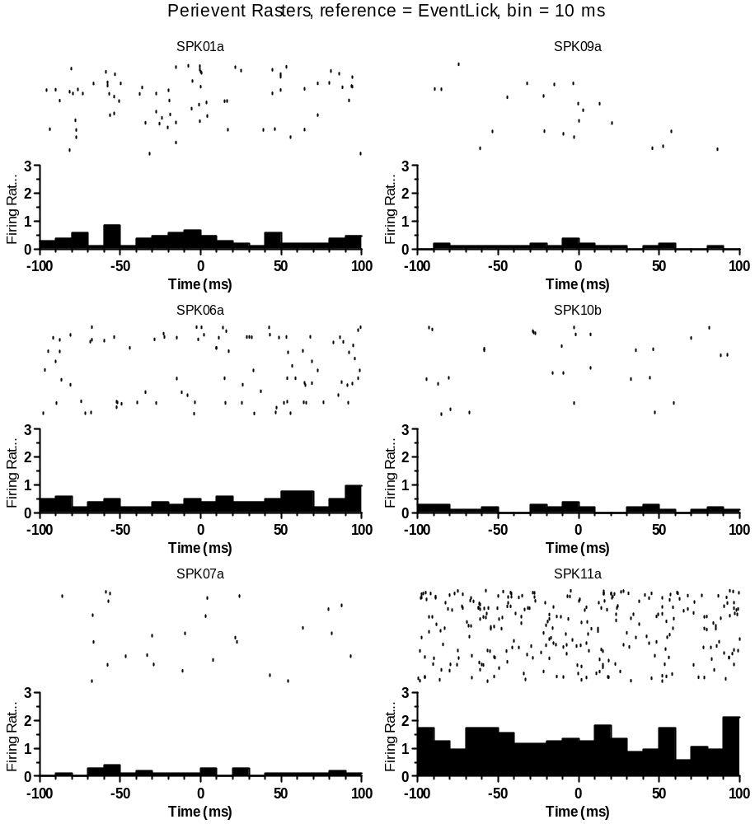
CeA CRF OA2-1 RecDay 3B-08252016-EtOH- FULL SESSION-ALL FIN.nex5: Perievent Rasters
Analysis Type = Perievent Rasters
Ref. Type = Fixed
Reference = EventLick
XMin (sec) = -0.1
XMax (sec) = 0.1
Trial Order = First On Top
Sort Trials = None
Sort Event = First after reference
Sort Ref. = EVT02
Histogram = Below
Hist. Height(%) = 45
Bin (sec) = 0.01
Normalization = Spikes/Sec
No Selfcount = 1
Select Data = All
Select Data From (sec) = 0
Select Data To (sec) = 14891.6363
Int. Filter Type = Fixed
Interval Filter = None
Create Filter on-the-fly = 0
Create Filter around = EVT02
Start Offset (sec) = 0
End Offset (sec) = 1
Fix Overlaps = 1
Smooth Histogram = None
Sm. Width = 3
Add Bin Left to Results = 0
Add Bin Middle to Results = 0
Add Bin Right to Results = 0
Run Postproc. Script = 0
Postprocessing Script =
Postproc. Script Parameter =
Representative PER for Non Responsive (all units here are classified as non-responsive)
Data File: D:\Users\James\Dropbox (Sparta Lab)\CeA CRF DID Ephys - Cleaned\All Final Clean nex Files by Drink\DATA-EtOH Only\CeA CRF OA2-1 RecDay 3B-08252016-EtOH- FULL SESSION-ALL FIN.nex5
May 03, 2018 16:27:26

Slide 2
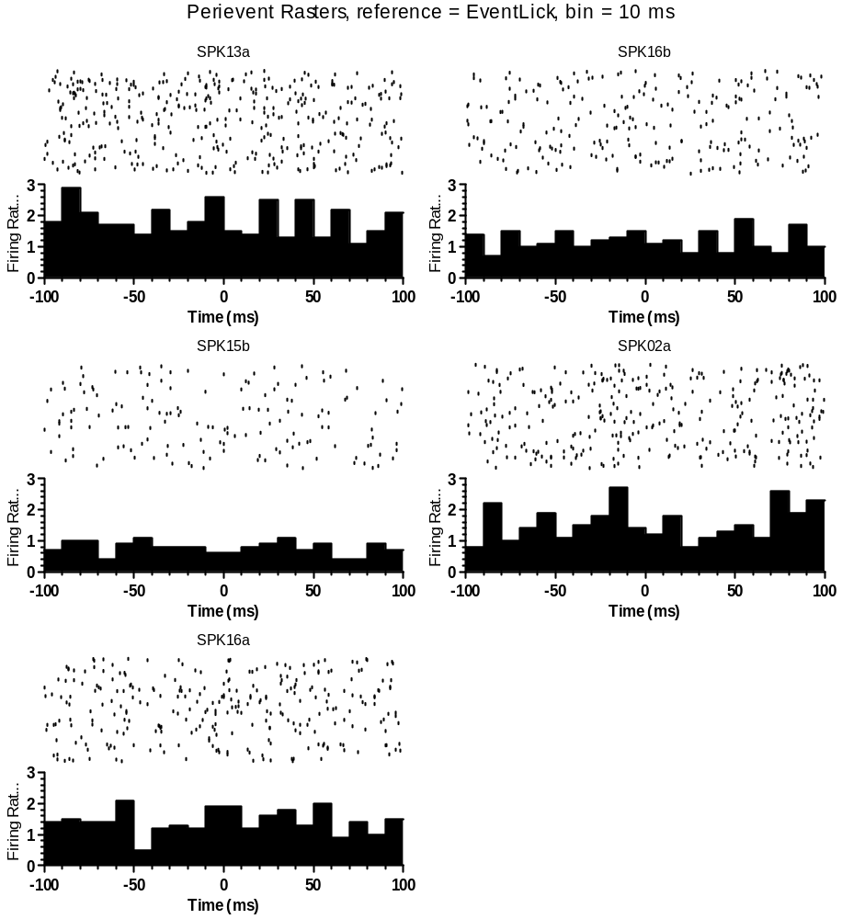
CeA CRF OA3-1_07262017_EtOH_FULL DID SESS_FIN.nex5: Perievent Rasters
Analysis Type = Perievent Rasters
Ref. Type = Fixed
Reference = EventLick
XMin (sec) = -0.1
XMax (sec) = 0.1
Trial Order = First On Top
Sort Trials = None
Sort Event = First after reference
Sort Ref. = EVT02
Histogram = Below
Hist. Height(%) = 45
Bin (sec) = 0.01
Normalization = Spikes/Sec
No Selfcount = 1
Select Data = All
Select Data From (sec) = 0
Select Data To (sec) = 14891.6363
Int. Filter Type = Fixed
Interval Filter = None
Create Filter on-the-fly = 0
Create Filter around = EVT02
Start Offset (sec) = 0
End Offset (sec) = 1
Fix Overlaps = 1
Smooth Histogram = None
Sm. Width = 3
Add Bin Left to Results = 0
Add Bin Middle to Results = 0
Add Bin Right to Results = 0
Run Postproc. Script = 0
Postprocessing Script =
Postproc. Script Parameter =
All CRF Non Responsive File 22
Data File: D:\Users\James\Dropbox (Sparta Lab)\CeA CRF DID Ephys - Cleaned\All Final Clean nex Files by Drink\DATA-EtOH Only\CeA CRF OA3-1_07262017_EtOH_FULL DID SESS_FIN.nex5
May 03, 2018 17:01:22

Slide 3
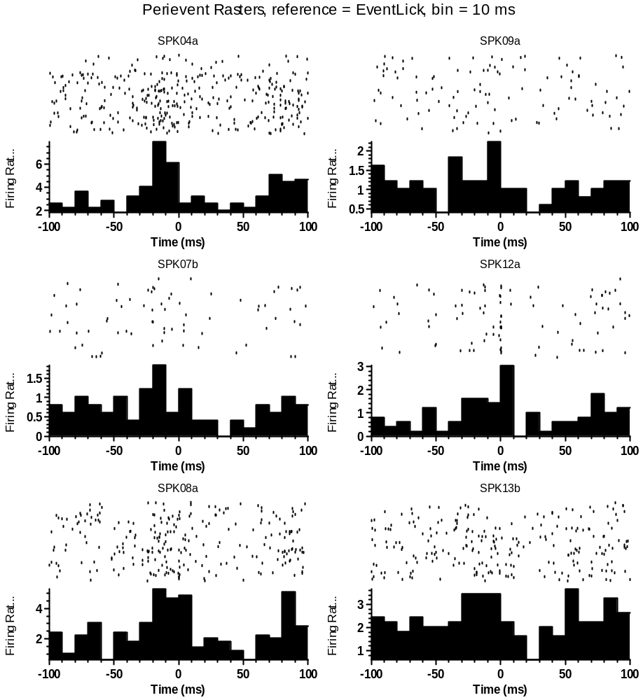
CeA CRF OA3-1_07262017_EtOH_FULL DID SESS_FIN.nex5: Perievent Rasters
Analysis Type = Perievent Rasters
Ref. Type = Fixed
Reference = EventLick
XMin (sec) = -0.1
XMax (sec) = 0.098
Trial Order = First On Top
Sort Trials = None
Sort Event = First after reference
Sort Ref. = EVT02
Histogram = Below
Hist. Height(%) = 45
Bin (sec) = 0.01
Normalization = Spikes/Sec
No Selfcount = 1
Select Data = From Time Range
Select Data From (sec) = 0
Select Data To (sec) = 7684.83361716
Int. Filter Type = Fixed
Interval Filter = None
Create Filter on-the-fly = 0
Create Filter around = EVT02
Start Offset (sec) = 0
End Offset (sec) = 1
Fix Overlaps = 1
Smooth Histogram = None
Sm. Width = 3
Add Bin Left to Results = 0
Add Bin Middle to Results = 0
Add Bin Right to Results = 0
Run Postproc. Script = 0
Postprocessing Script =
Postproc. Script Parameter =
Data File: D:\Users\James\Dropbox (Sparta Lab)\CeA CRF DID Ephys - Cleaned\All Final Clean nex Files by Drink\DATA-EtOH Only\CeA CRF OA3-1_07262017_EtOH_FULL DID SESS_FIN.nex5
May 03, 2018 17:42:55

